Slide 1
Tools: Interstate Disaster Communications

Slide 2
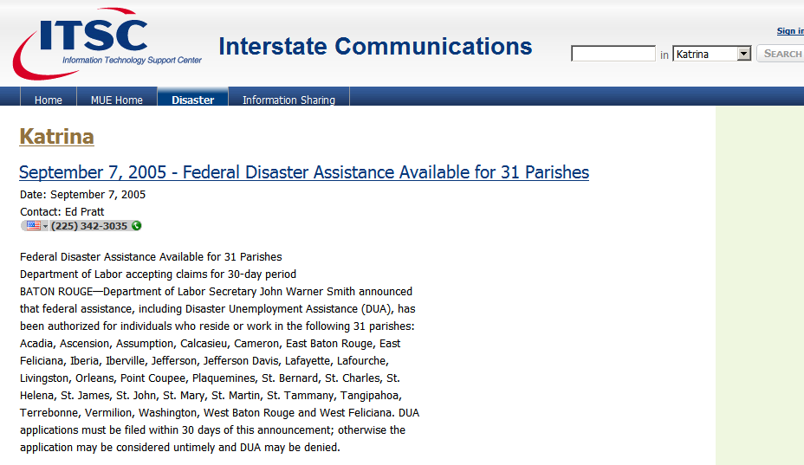
Tools: Interstate Disaster Communications

Slide 3
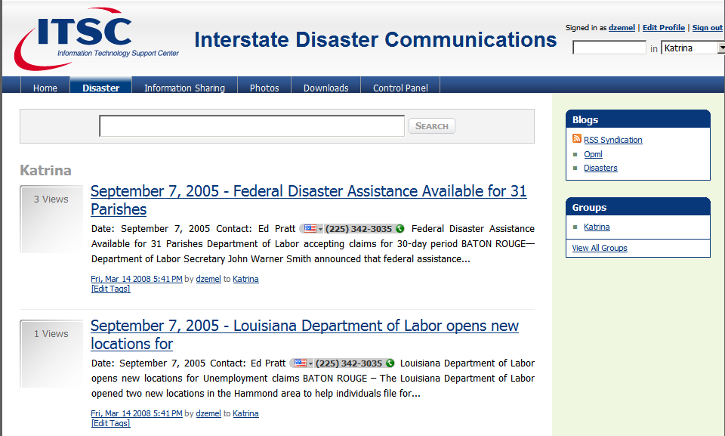
Tools: Interstate Disaster Communications

Slide 4
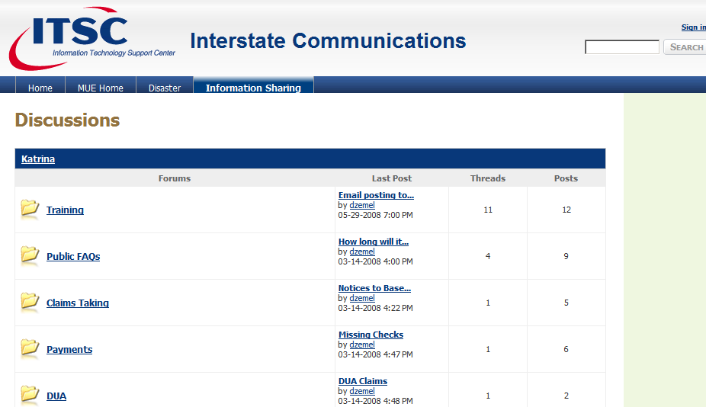
Tools: Interstate Disaster Communications

